Slide 1
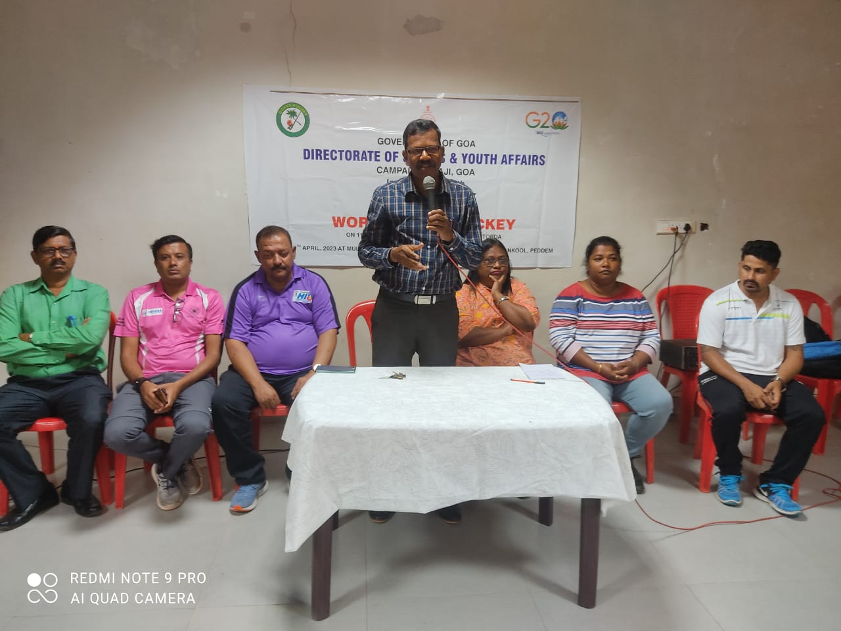
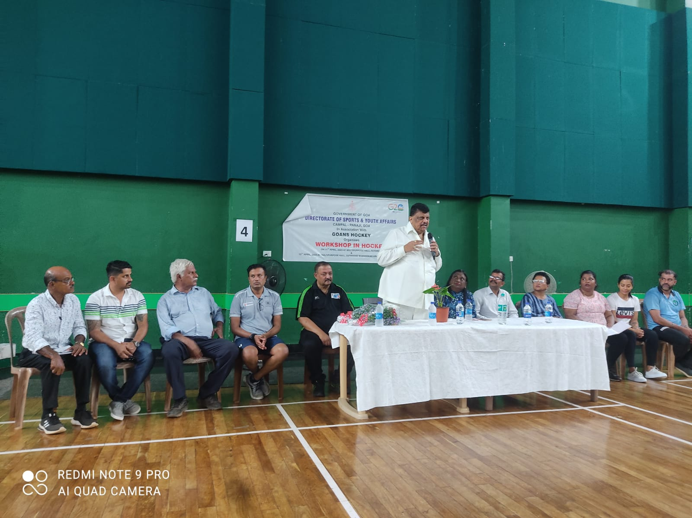
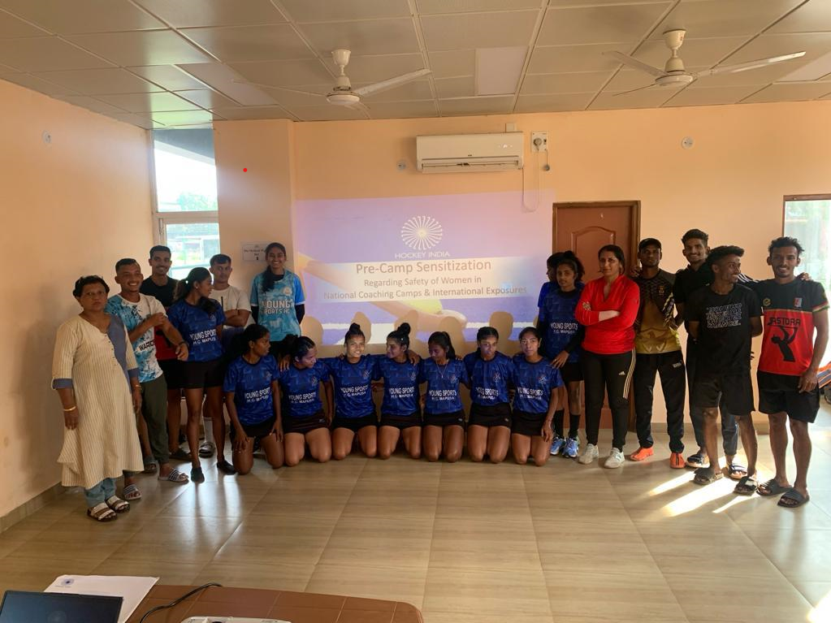
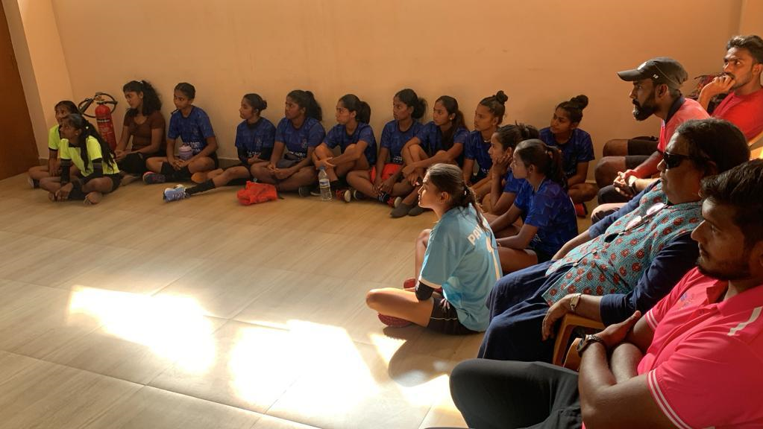
ORIENTATION CAMMP ON THE NEW RULES OF HOCKEY WAS HELD IN COLLABORATION WITH DIRECTORATE OF SPORTS AND YOUTH AFFAIRS AND HOCKEY INDIA FOR PHYSICAL EDUCATION TEACHERS AND PLAYERS . Ddirectorate of sports and youth affairs and hockey india. OF HOCKEY
PRE SENSITIZATION CAMP WAS HELD FOR COACHES, PLAYERS AND TECHNICAL STAFF ON THE AWARENESS OF
SEXUAL HARASSEMENT TO PLAYERS AT CAMP CENTRES. THE TALK WAS GIVEN BY ADV. CANDIDA FERNANDES AND PROF. NELLY RODRIGUES

